Slide 1
Matthew 24:36-44
Story of Salvation #9:
Jesus Will Return

Slide 2
1 Thessalonians 4:16-17
For the Lord himself will descend from heaven with a cry of command, with the voice of an archangel, and with the sound of the trumpet of God. And the dead in Christ will rise first. Then we who are alive, who are left, will be caught up together with them in the clouds to meet the Lord in the air, and so we will always be with the Lord.

Slide 3
Matthew 24:36-37
“But concerning that day and hour no one knows, not even the angels of heaven, nor the Son, but the Father only. For as were the days of Noah, so will be the coming of the Son of Man.

Slide 4
Matthew 24:38-39
For as in those days before the flood they were eating and drinking, marrying and giving in marriage, until the day when Noah entered the ark, and they were unaware until the flood came and swept them all away, so will be the coming of the Son of Man.

Slide 5
Matthew 24:40-42
Then two men will be in the field; one will be taken and one left. Two women will be grinding at the mill; one will be taken and one left. Therefore, stay awake, for you do not know on what day your Lord is coming.

Slide 6
Matthew 24:43-44
But know this, that if the master of the house had known in what part of the night the thief was coming, he would have stayed awake and would not have let his house be broken into. Therefore you also must be ready, for the Son of Man is coming at an hour you do not expect.

Slide 7

The Unknown Hour of Jesus’s Return

Slide 8
“Nor the Son”
Option 1: Jesus in His human nature did not know
Option 2: Different roles within the Trinity

Slide 9
Illustration #1:
Noah and the Flood

Slide 10
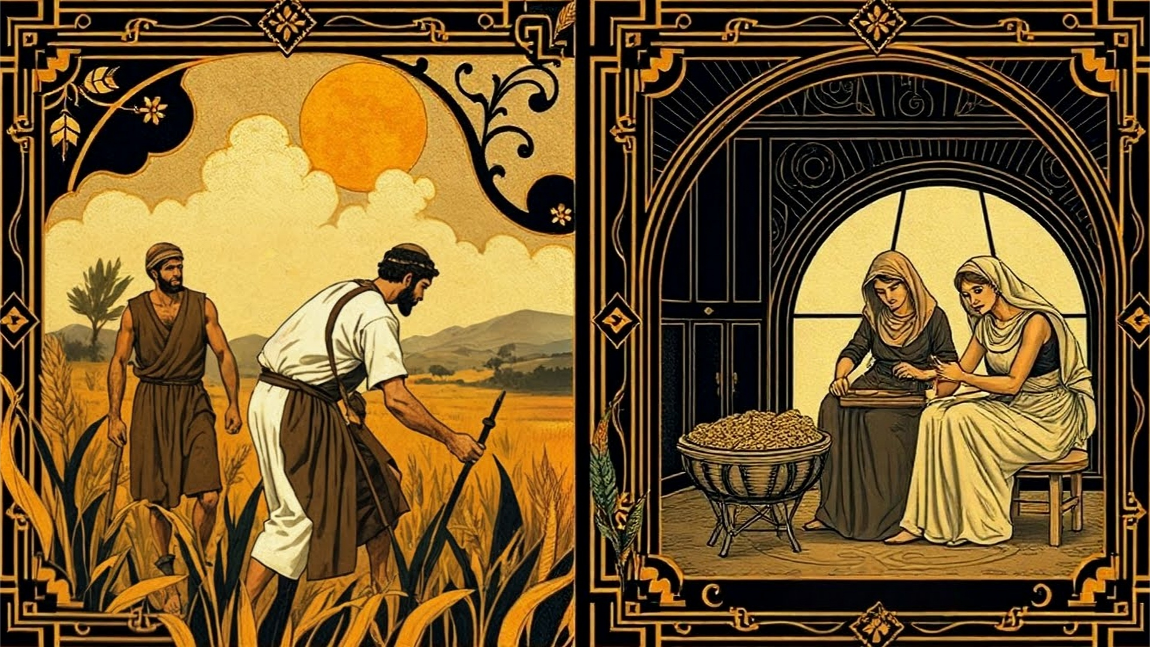

Slide 11
“Therefore, stay awake!”

Slide 12
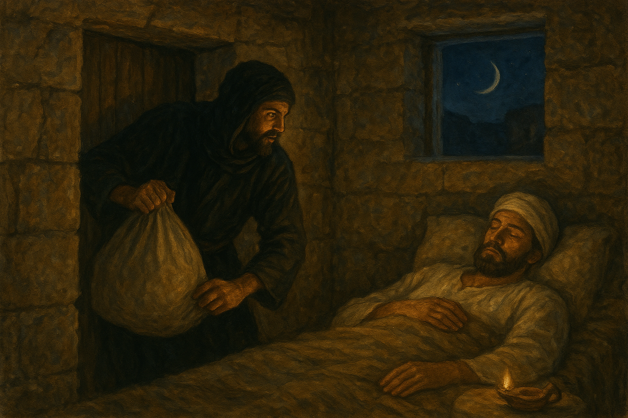
Illustration #2: The Thief

Slide 13
“Therefore, you also must be ready!”

