Slide 1

Luke 8:4-15
Story of Salvation #10
Hear!

Slide 2
Deuteronomy 6:4-5
⁴ “Hear, O Israel: The Lord our God, the Lord is one. ⁵ You shall love the Lord your God with all your heart and with all your soul and with all your might.

Slide 3
1 Samuel 15:22
²² And Samuel said, “Has the Lord as great delight in burnt offerings and sacrifices, as in obeying the voice of the Lord? Behold, to obey is better than sacrifice, and to listen than the fat of rams.

Slide 4
Matthew 17:5
⁵ He was still speaking when, behold, a bright cloud overshadowed them, and a voice from the cloud said, “This is my beloved Son, with whom I am well pleased; listen to him.”

Slide 5
Luke 8:4-5
⁴ And when a great crowd was gathering and people from town after town came to him, he said in a parable, ⁵ “A sower went out to sow his seed. And as he sowed, some fell along the path and was trampled underfoot, and the birds of the air devoured it.

Slide 6
Luke 8:6-7
⁶ And some fell on the rock, and as it grew up, it withered away, because it had no moisture. ⁷ And some fell among thorns, and the thorns grew up with it and choked it.

Slide 7
Luke 8:8
⁸ And some fell into good soil and grew and yielded a hundredfold.” As he said these things, he called out, “He who has ears to hear, let him hear.”

Slide 8
Luke 8:9-10
⁹ And when his disciples asked him what this parable meant, ¹⁰ he said, “To you it has been given to know the secrets of the kingdom of God, but for others they are in parables, so that ‘seeing they may not see, and hearing they may not understand.’

Slide 9
Luke 8:11-12
¹¹ Now the parable is this: The seed is the word of God. ¹² The ones along the path are those who have heard; then the devil comes and takes away the word from their hearts, so that they may not believe and be saved.

Slide 10
Luke 8:13
¹³ And the ones on the rock are those who, when they hear the word, receive it with joy. But these have no root; they believe for a while, and in time of testing fall away.

Slide 11
Luke 8:14
¹⁴ And as for what fell among the thorns, they are those who hear, but as they go on their way they are choked by the cares and riches and pleasures of life, and their fruit does not mature.

Slide 12
Luke 8:15
¹⁵ As for that in the good soil, they are those who, hearing the word, hold it fast in an honest and good heart, and bear fruit with patience.

Slide 13
The Parable

Slide 14
Isaiah 6:9
⁹ And he said, “Go, and say to this people: “‘Keep on hearing, but do not understand; keep on seeing, but do not perceive.’

Slide 15
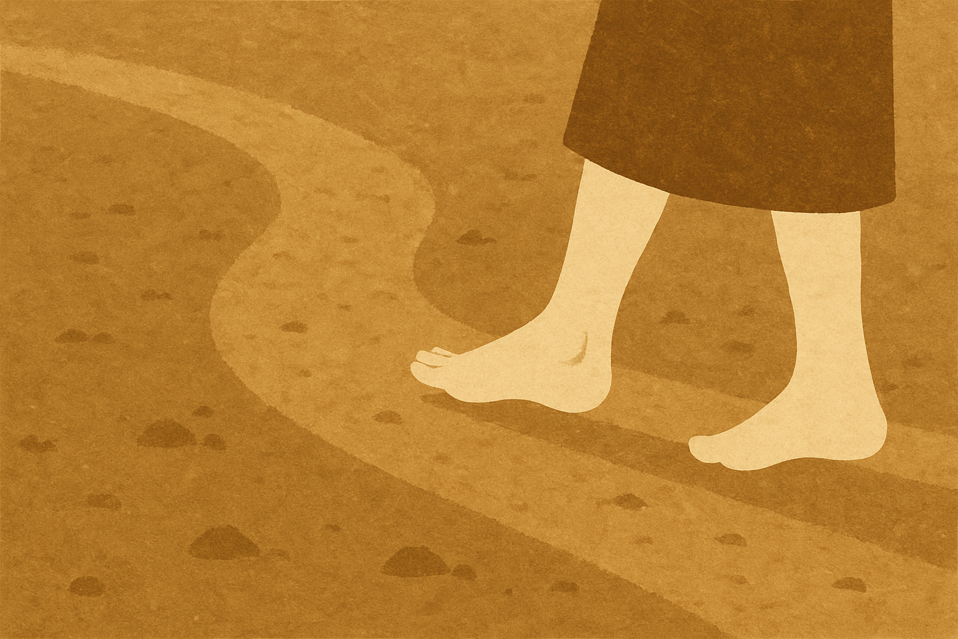
Soil #1: The Path

Slide 16
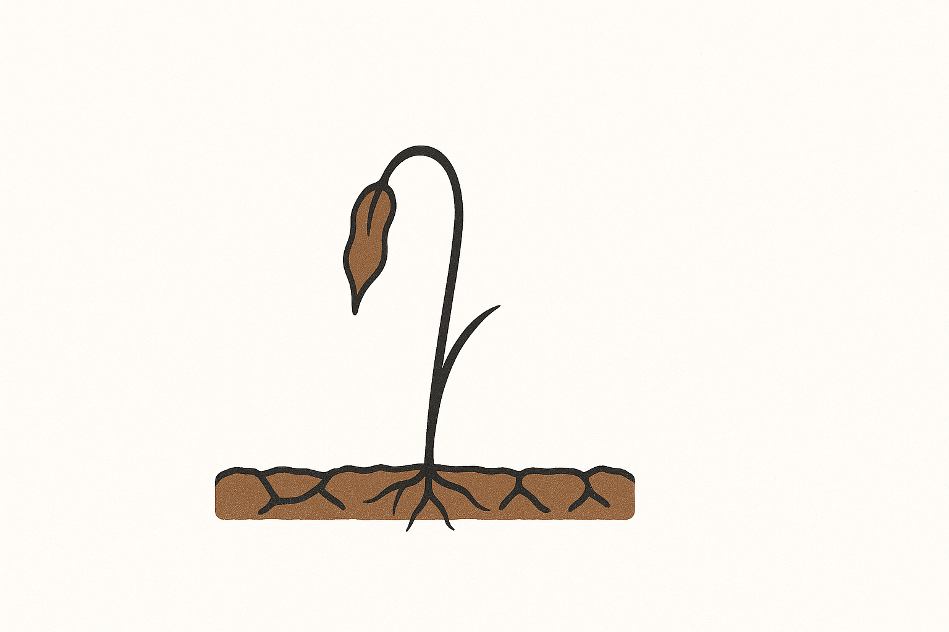
Soil #2: Rocky

Slide 17

Soil #3: Thorns

Slide 18
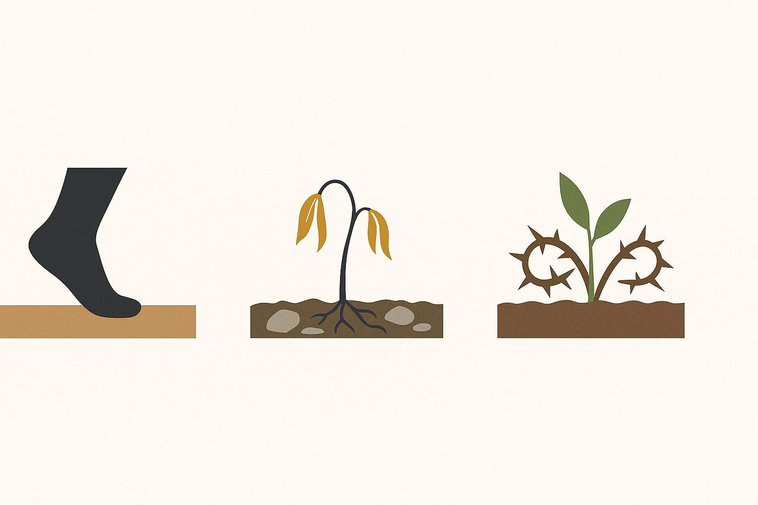

Slide 19

Soil #4: Good

Slide 20
“He who has ears to hear, let him hear!”

