Slide 1
Philippians 2:9-11
The Story of Salvation #8
Jesus is Exalted

Slide 2

“After making purification for sins, he sat down at the right hand of the Majesty on high, having become as much superior to angels as the name he has inherited is more excellent than theirs.” (Hebrews 1:3-4)

Slide 3
Philippians 2:3-5
Do nothing from selfish ambition or conceit, but in humility count others more significant than yourselves. Let each of you look not only to his own interests, but also to the interests of others. Have this mind among yourselves, which is yours in Christ Jesus,

Slide 4
Philippians 2:6-7
who, though he was in the form of God, did not count equality with God a thing to be grasped, but emptied himself, by taking the form of a servant, being born in the likeness of men.

Slide 5
Philippians 2:8-9
And being found in human form, he humbled himself by becoming obedient to the point of death, even death on a cross. Therefore God has highly exalted him and bestowed on him the name that is above every name,

Slide 6
Philippians 2:10-11
so that at the name of Jesus every knee should bow, in heaven and on earth and under the earth, and every tongue confess that Jesus Christ is Lord, to the glory of God the Father.

Slide 7
God’s Action
Exaltation of Jesus

Slide 8
Daniel 7:13-14
“I saw in the night visions, and behold, with the clouds of heaven there came one like a son of man, and he came to the Ancient of Days and was presented before him. And to him was given dominion and glory and a kingdom, that all peoples, nations, and languages should serve him; his dominion is an everlasting dominion, which shall not pass away, and his kingdom one that shall not be destroyed.

Slide 9
God’s Action
Exaltation of Jesus
Bestowal of the Name

Slide 10
Isaiah 45:22-23
“Turn to me and be saved, all the ends of the earth! For I am God, and there is no other. By myself I have sworn; from my mouth has gone out in righteousness a word that shall not return: ‘To me every knee shall bow, every tongue shall swear allegiance.’

Slide 11
Matthew 28:18-19
¹⁸ And Jesus came and said to them, “All authority in heaven and on earth has been given to me. ¹⁹ Go therefore and make disciples of all nations, baptizing them in the name of the Father and of the Son and of the Holy Spirit

Slide 12
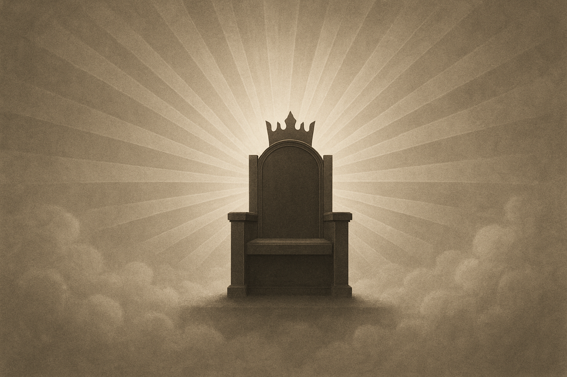

Slide 13
Revelation 5:13-14
And I heard every creature in heaven and on earth and under the earth and in the sea, and all that is in them, saying, “To him who sits on the throne and to the Lamb be blessing and honor and glory and might forever and ever!” And the four living creatures said, “Amen!” and the elders fell down and worshiped.

Slide 14
Creation’s Response
Every knee should bow
Every tongue confess

Slide 15
Romans 10:9
because, if you confess with your mouth that Jesus is Lord and believe in your heart that God raised him from the dead, you will be saved.

Slide 16
Every knee will bow, every tongue confess; however, not all are saved

Slide 17
Luke 8:28
When he saw Jesus, he cried out and fell down before him and said with a loud voice, “What have you to do with me, Jesus, Son of the Most High God? I beg you, do not torment me.”

Slide 18
Bow and confess as a servant or as an enemy

Slide 19
Psalm 2:10-12
Now therefore, O kings, be wise; be warned, O rulers of the earth. Serve the Lord with fear, and rejoice with trembling. Kiss the Son, lest he be angry, and you perish in the way, for his wrath is quickly kindled. Blessed are all who take refuge in him.

