Slide 1
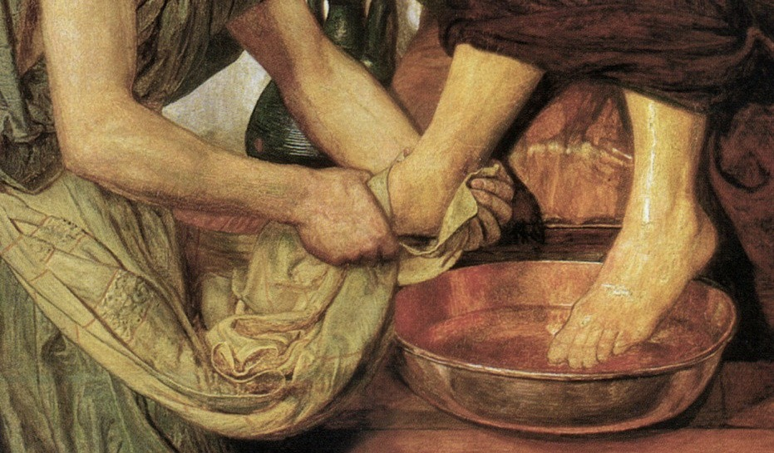
John 13:1-17
The Story of Salvation #5
Jesus Lived as a Man

Slide 2

John 13:1-2
Now before the Feast of the Passover, when Jesus knew that his hour had come to depart out of this world to the Father, having loved his own who were in the world, he loved them to the end. During supper, when the devil had already put it into the heart of Judas Iscariot, Simon's son, to betray him,

Slide 3
John 13:3-4
Jesus, knowing that the Father had given all things into his hands, and that he had come from God and was going back to God, rose from supper. He laid aside his outer garments, and taking a towel, tied it around his waist.

Slide 4
John 13:5-7
Then he poured water into a basin and began to wash the disciples' feet and to wipe them with the towel that was wrapped around him. He came to Simon Peter, who said to him, “Lord, do you wash my feet?” Jesus answered him, “What I am doing you do not understand now, but afterward you will understand.”

Slide 5
John 13:8-9
Peter said to him, “You shall never wash my feet.” Jesus answered him, “If I do not wash you, you have no share with me.” Simon Peter said to him, “Lord, not my feet only but also my hands and my head!”

Slide 6
John 13:10-11
Jesus said to him, “The one who has bathed does not need to wash, except for his feet, but is completely clean. And you are clean, but not every one of you.” For he knew who was to betray him; that was why he said, “Not all of you are clean.”

Slide 7
John 13:12-14
When he had washed their feet and put on his outer garments and resumed his place, he said to them, “Do you understand what I have done to you? You call me Teacher and Lord, and you are right, for so I am. If I then, your Lord and Teacher, have washed your feet, you also ought to wash one another's feet.

Slide 8
John 13:15-17
For I have given you an example, that you also should do just as I have done to you. Truly, truly, I say to you, a servant is not greater than his master, nor is a messenger greater than the one who sent him. If you know these things, blessed are you if you do them.

Slide 9
Our Lord Became a Servant:
Timing

Slide 10
Our Lord Became a Servant:
Change of Attire

Slide 11
Matthew 17:1-2
And after six days Jesus took with him Peter and James, and John his brother, and led them up a high mountain by themselves. ² And he was transfigured before them, and his face shone like the sun, and his clothes became white as light.

Slide 12
Philippians 2:6-8
⁶ who, though he was in the form of God, did not count equality with God a thing to be grasped, ⁷ but emptied himself, by taking the form of a servant, being born in the likeness of men. ⁸ And being found in human form, he humbled himself by becoming obedient to the point of death, even death on a cross.

Slide 13
Our Lord Became a Servant:
Washing Feet

Slide 14
Matthew 5:43-45
⁴³ “You have heard that it was said, ‘You shall love your neighbor and hate your enemy.’ ⁴⁴ But I say to you, Love your enemies and pray for those who persecute you, ⁴⁵ so that you may be sons of your Father who is in heaven.

Slide 15
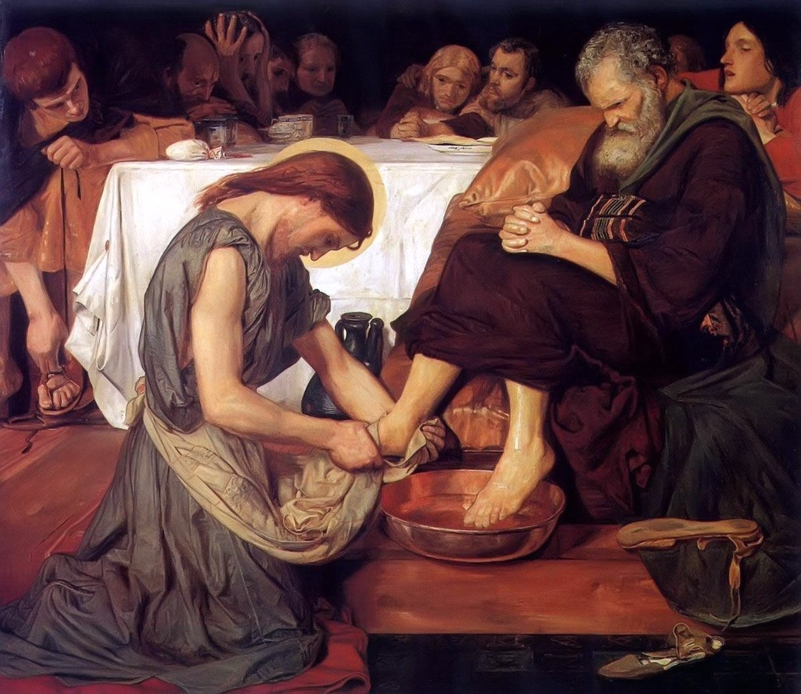
Jesus and Peter

Slide 16
Jesus Speaks to Peter
We must be washed by Jesus
Continual cleansing is necessary

Slide 17
1 John 1:8-9
⁸ If we say we have no sin, we deceive ourselves, and the truth is not in us. ⁹ If we confess our sins, he is faithful and just to forgive us our sins and to cleanse us from all unrighteousness.

Slide 18
Jesus Speaks to Peter
We must be washed by Jesus
Continual cleansing is necessary
Outward conformity does not guarantee inward change

Slide 19
Jesus Speaks to His Disciples

Slide 20
Jesus Lived as a Man to Set an Example

