Slide 1
Elders and Deacons
1 Timothy 3:1-13

Slide 2
Church Organization
Congregational
Two-Tiered: Elders and Deacons
Plurality of Elders

Slide 3
“Pastor” and “Bishop”
Pastor = Shepherd
Bishop = Overseer

Slide 4
1 Timothy 3:1-2
The saying is trustworthy: If anyone aspires to the office of overseer, he desires a noble task. Therefore an overseer must be above reproach, the husband of one wife, sober-minded, self-controlled, respectable, hospitable, able to teach,

Slide 5
1 Timothy 3:3-5
not a drunkard, not violent but gentle, not quarrelsome, not a lover of money. He must manage his own household well, with all dignity keeping his children submissive, for if someone does not know how to manage his own household, how will he care for God's church?

Slide 6
1 Timothy 3:6-7
He must not be a recent convert, or he may become puffed up with conceit and fall into the condemnation of the devil. Moreover, he must be well thought of by outsiders, so that he may not fall into disgrace, into a snare of the devil.

Slide 7
1 Timothy 3:8-10
Deacons likewise must be dignified, not double-tongued, not addicted to much wine, not greedy for dishonest gain. They must hold the mystery of the faith with a clear conscience. And let them also be tested first; then let them serve as deacons if they prove themselves blameless.

Slide 8
1 Timothy 3:11-12
Their wives likewise must be dignified, not slanderers, but sober-minded, faithful in all things. Let deacons each be the husband of one wife, managing their children and their own households well.

Slide 9
1 Timothy 3:13
For those who serve well as deacons gain a good standing for themselves and also great confidence in the faith that is in Christ Jesus.

Slide 10
Elder / Shepherd / Overseer
Obey your leaders and submit to them, for they are keeping watch over your souls, as those who will have to give an account. Let them do this with joy and not with groaning, for that would be of no advantage to you. (Hebrews 13:17)

Slide 11
Elder / Shepherd / Overseer
² shepherd the flock of God that is among you, exercising oversight … ³ not domineering over those in your charge, but being examples to the flock.
(1 Peter 5:2-3)

Slide 12
“Elder”
Old enough to have wisdom gained by life experience
Ruling, making decisions

Slide 13
“Shepherd”
Feeding
Guiding
Protecting
Seeking

Slide 14
“Overseer”
Oversight
Management

Slide 15
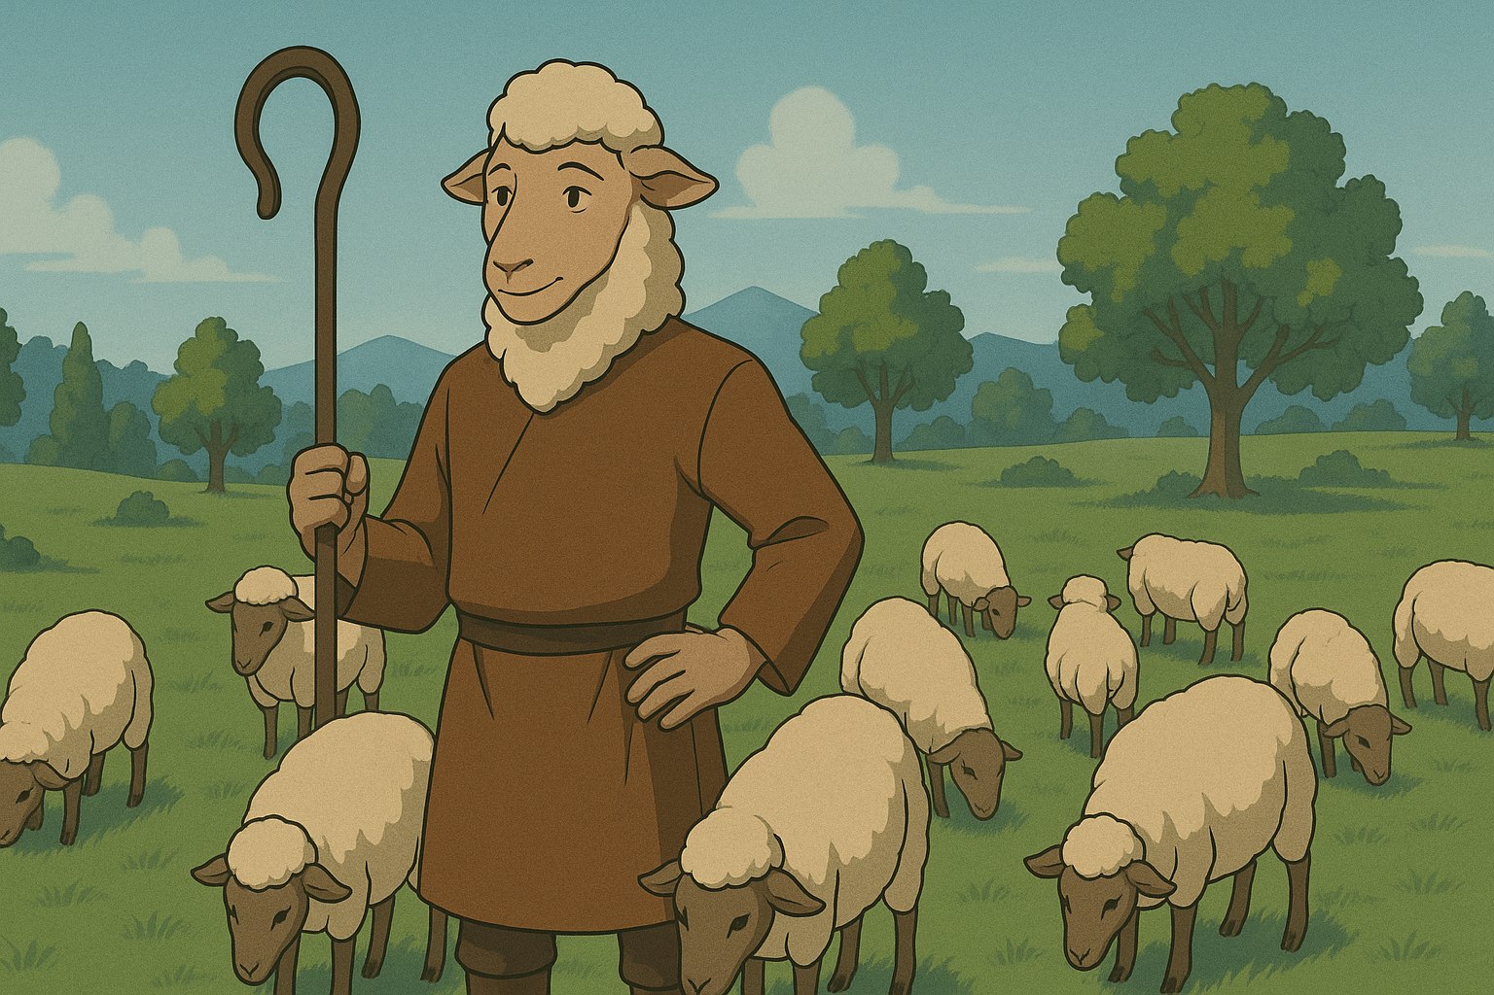

Slide 16
Deacon
“Deacon” = Servant, Helper, Minister

Slide 17
The Eldership’s Right-Hand Men

Slide 18
Deacons and Acts 6

Slide 19
What does a Deacon do?
Whatever is needed

Slide 20
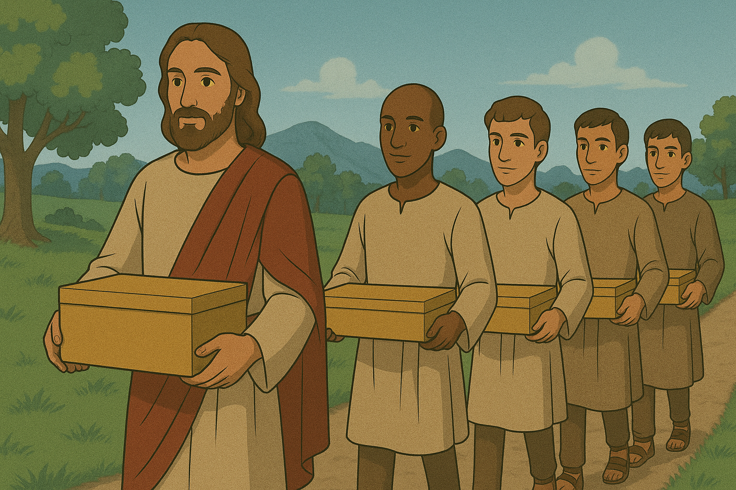
John 13:12-15

Slide 21
The Qualifications
Spiritual Maturity
Proven through their own household
Wives of spiritual maturity

Slide 22
The Qualifications
Elders: Not a recent convert and able to teach
Deacons: Hold the faith sincerely and prove by testing

Slide 23
The Privilege and the Responsibility

