Slide 1
John 1:1-14
The Story of Salvation #4
The Word Becomes Flesh

Slide 2
Consequences of Sin
The Fall
Cain and Abel
The Flood
The Tower of Babel
Joseph sold into slavery

Slide 3
Consequences of Sin
Israel rebels in the wilderness
Cycle of failure during Judges
Division of the kingdom
Primarily evil kings
Persistent idolatry

Slide 4
Consequences of Sin
Assyria conquers Israel
Babylon conquers Judah

Slide 5
Strand of Hope
Proto-Evangelium (First-Gospel)
Noah is preserved
God makes a covenant with Abraham
Covenant passed to Isaac, Jacob

Slide 6
Strand of Hope
God remains with Joseph in Egypt
The Exodus
Mosaic covenant
Promise to David
Prophets look forward in hope

Slide 7
Pictures of Messiah
Seed of woman (Gen. 3:15)
Sacrificial system
A prophet like Moses (Deut. 18:15)
Ideal Davidic king
Suffering Servant

Slide 8
Pictures of Messiah
Melchizedek
The Angel of the Lord
Psalms and Prophets

Slide 9
John 1:1-3
In the beginning was the Word, and the Word was with God, and the Word was God. He was in the beginning with God. All things were made through him, and without him was not any thing made that was made.

Slide 10
John 1:4-6
In him was life, and the life was the light of men. The light shines in the darkness, and the darkness has not overcome it. There was a man sent from God, whose name was John.

Slide 11
John 1:7-9
He came as a witness, to bear witness about the light, that all might believe through him. He was not the light, but came to bear witness about the light. The true light, which gives light to everyone, was coming into the world.

Slide 12
John 1:10-11
He was in the world, and the world was made through him, yet the world did not know him. He came to his own, and his own people did not receive him.

Slide 13
John 1:12-13
But to all who did receive him, who believed in his name, he gave the right to become children of God, who were born, not of blood nor of the will of the flesh nor of the will of man, but of God.

Slide 14
John 1:14
And the Word became flesh and dwelt among us, and we have seen his glory, glory as of the only Son from the Father, full of grace and truth.

Slide 15
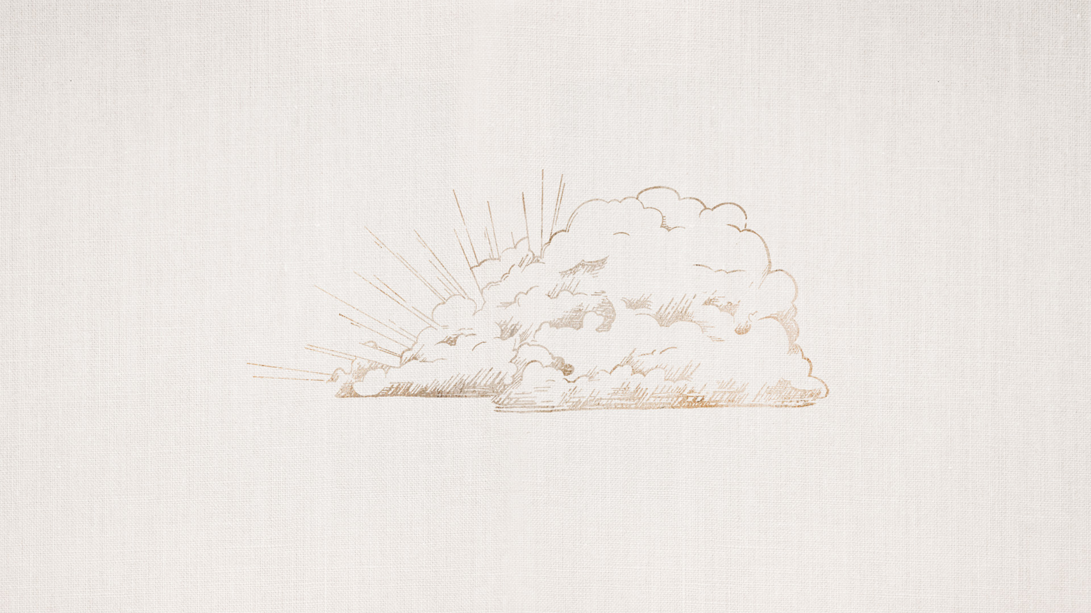
In the Beginning Was the Word

Slide 16
Genesis 15:4-5
⁴ And behold, the word of the Lord came to him: “This man shall not be your heir; your very own son shall be your heir.” ⁵ And he brought him outside and said, “Look toward heaven, and number the stars, if you are able to number them.” Then he said to him, “So shall your offspring be.”

Slide 17
The Divinity of the Word

Slide 18
Let there be Light!

Slide 19
John 3:19
“And this is the judgment: the light has come into the world, and people loved the darkness rather than the light because their works were evil.”

Slide 20
The Right to Become Children of God

Slide 21
1 John 3:1-2
See what kind of love the Father has given to us, that we should be called children of God; and so we are. The reason why the world does not know us is that it did not know him. ² Beloved, we are God's children now, and what we will be has not yet appeared; but we know that when he appears we shall be like him, because we shall see him as he is.

Slide 22
The Word Became Flesh and Dwelt Among Us

