Slide 1
1 Thessalonians 2:13-16
Receiving the Gospel

Slide 2
1 Thessalonians 2:13
And we also thank God constantly for this, that when you received the word of God, which you heard from us, you accepted it not as the word of men but as what it really is, the word of God, which is at work in you believers.

Slide 3
1 Thessalonians 2:14
For you, brothers, became imitators of the churches of God in Christ Jesus that are in Judea. For you suffered the same things from your own countrymen as they did from the Jews,

Slide 4
1 Thessalonians 2:15
who killed both the Lord Jesus and the prophets, and drove us out, and displease God and oppose all mankind

Slide 5
1 Thessalonians 2:16
by hindering us from speaking to the Gentiles that they might be saved—so as always to fill up the measure of their sins. But wrath has come upon them at last!

Slide 6
The Gospel:
The Word of God

Slide 7
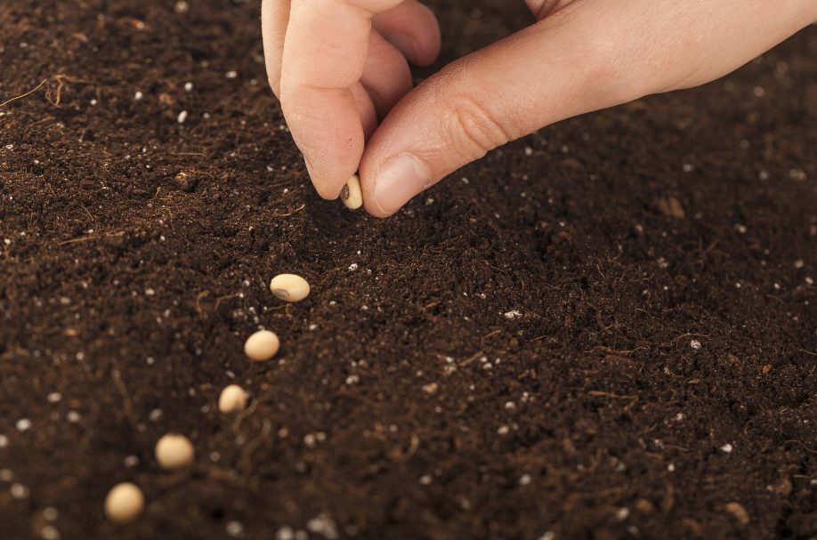

Slide 8
Hebrews 4:12
For the word of God is living and active, sharper than any two-edged sword, piercing to the division of soul and of spirit, of joints and of marrow, and discerning the thoughts and intentions of the heart.

Slide 9
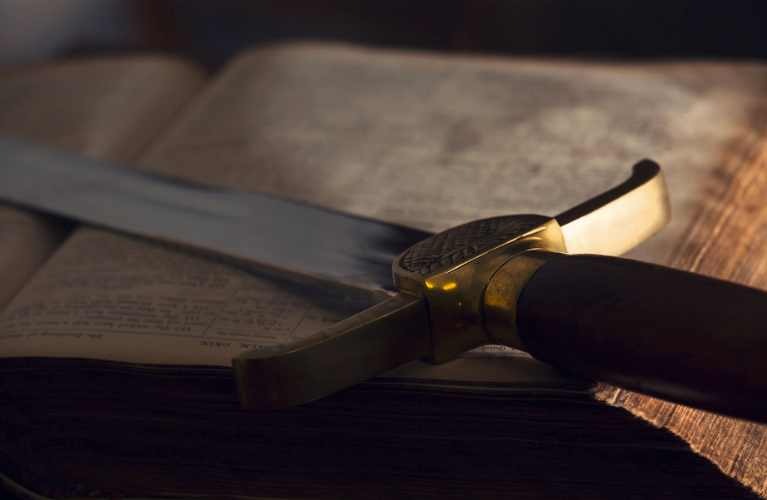

Slide 10
The Gospel:
Worth Suffering For

Slide 11
The Gospel is TRUE

Slide 12
The Gospel:
Not to be Hindered

Slide 13
To hinder the gospel is to:
Displease God
Oppose Mankind

Slide 14
Wrath or Grace

