Slide 1
Colossians 4:2-18

Slide 2
Paul’s General Letter Pattern:
Introductory Remarks
Theological Foundation
Practical Application
Concluding Remarks and Greetings

Slide 3
Colossians 4:2-4
Continue steadfastly in prayer, being watchful in it with thanksgiving. At the same time, pray also for us, that God may open to us a door for the word, to declare the mystery of Christ, on account of which I am in prison— that I may make it clear, which is how I ought to speak.

Slide 4
Colossians 4:5-6
Walk in wisdom toward outsiders, making the best use of the time. Let your speech always be gracious, seasoned with salt, so that you may know how you ought to answer each person.

Slide 5
Paul’s Focus on Evangelism
(4:2-6)

Slide 6
1 Peter 3:15
“in your hearts honor Christ the Lord as holy, always being prepared to make a defense to anyone who asks you for a reason for the hope that is in you; yet do it with gentleness and respect”

Slide 7
“Salty” Speech

Slide 8
Colossians 4:7-8
Tychicus will tell you all about my activities. He is a beloved brother and faithful minister and fellow servant in the Lord. I have sent him to you for this very purpose, that you may know how we are and that he may encourage your hearts,

Slide 9
Colossians 4:9
and with him Onesimus, our faithful and beloved brother, who is one of you. They will tell you of everything that has taken place here.

Slide 10
Colossians 4:10-11
Aristarchus my fellow prisoner greets you, and Mark the cousin of Barnabas (concerning whom you have received instructions—if he comes to you, welcome him), and Jesus who is called Justus. These are the only men of the circumcision among my fellow workers for the kingdom of God, and they have been a comfort to me.

Slide 11
Colossians 4:12-13
Epaphras, who is one of you, a servant of Christ Jesus, greets you, always struggling on your behalf in his prayers, that you may stand mature and fully assured in all the will of God. For I bear him witness that he has worked hard for you and for those in Laodicea and in Hierapolis.

Slide 12
Colossians 4:14-15
Luke the beloved physician greets you, as does Demas. Give my greetings to the brothers at Laodicea, and to Nympha and the church in her house.

Slide 13
Colossians 4:16-17
And when this letter has been read among you, have it also read in the church of the Laodiceans; and see that you also read the letter from Laodicea. And say to Archippus, “See that you fulfill the ministry that you have received in the Lord.”

Slide 14
Colossians 4:18
I, Paul, write this greeting with my own hand. Remember my chains. Grace be with you.

Slide 15
Final Greetings
(4:7-17)

Slide 16
Letter Bearers
Tychicus
Onesimus

Slide 17
Paul’s Jewish Companions
Aristarchus
Mark
Jesus/Justus

Slide 18
Paul’s Gentile Companions
Epaphras
Luke
Demas

Slide 19
Greetings to…
The brethren in Laodicea
Nympha and the church in her house
Archippus

Slide 20
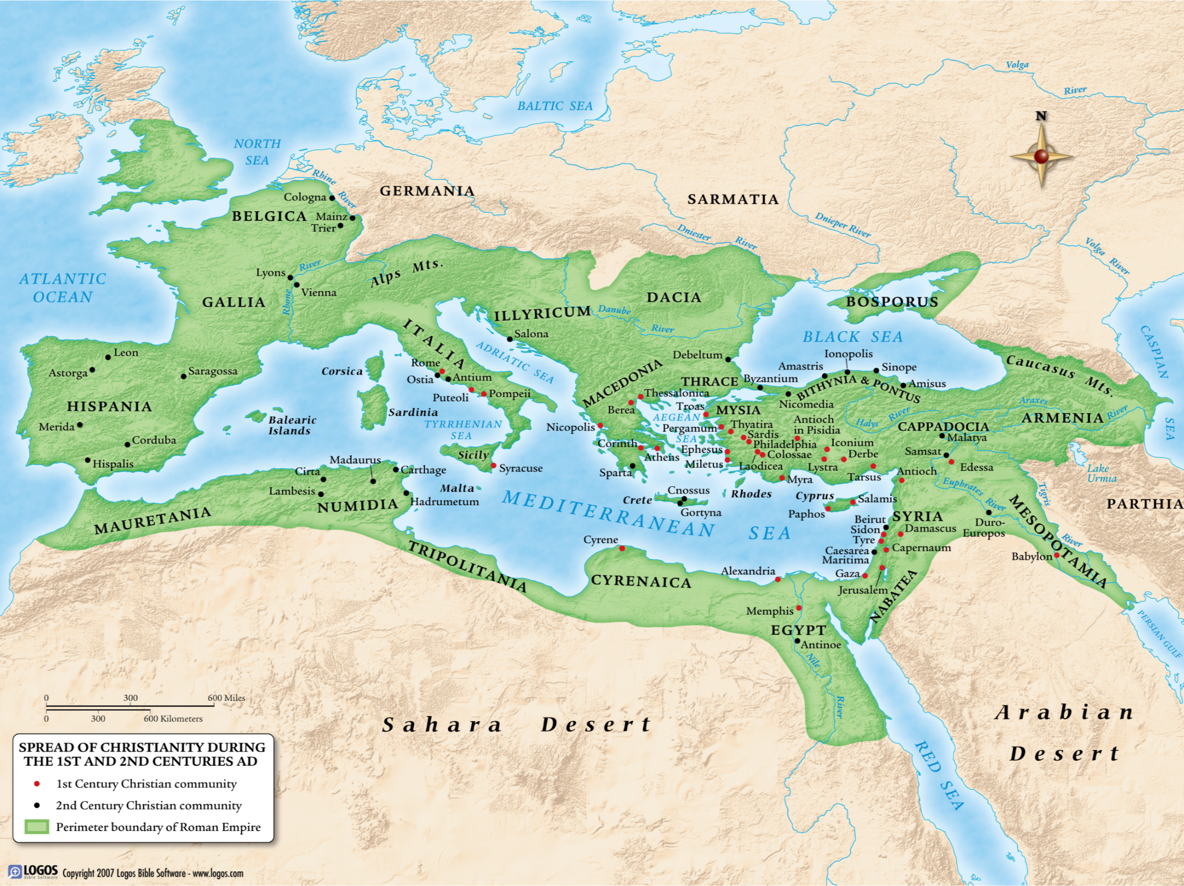
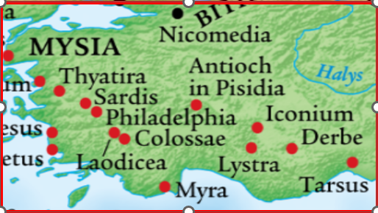

Slide 21
Greetings to…
The brethren in Laodicea
Nympha and the church in her house
Archippus

Slide 22
Lessons from the List of Names
Real people, real relationships, real struggles
Be careful, lest you fall: Demas
Paul is not a one-man show

Slide 23
Lessons from the List of Names
Real people, real relationships, real struggles
Be careful, lest you fall: Demas
Paul is not a one-man show

Slide 24
2 Timothy 4:10
“For Demas, in love with this present world, has deserted me and gone to Thessalonica.”

Slide 25
Lessons from the List of Names
Real people, real relationships, real struggles
Be careful, lest you fall: Demas
Paul is not a one-man show

Slide 26
Grace to You
(4:18)

Slide 27
Colossians, ESV Headings
Greeting (1:1-2)
Thanksgiving and Prayer (1:3-14)
The Preeminence of Christ (1:15-23)
Paul’s Ministry to the Church (1:24 – 2:5)
Alive in Christ (2:6-15)

Slide 28
Colossians, ESV Headings
Let No One Disqualify You (2:16-23)
Put on the New Self (3:1-17)
Rules for Christian Households (3:18-4:1)
Further Instructions (4:2-6)
Final Greetings (4:7-18)

Slide 29
Colossians: Walk in the Wisdom of God

Slide 30
1:6, “since the day you heard it [the gospel] and understood the grace of God in truth
1:9-10, “be filled with the knowledge of his will in all spiritual wisdom and understanding, so as to walk in a manner worthy of the Lord … increasing in the knowledge of God”
1:28, “teaching everyone with all wisdom”

Slide 31
2:2-3, “the riches of full assurance of understanding and the knowledge of God’s mystery, which is Christ, in whom are hidden all the treasures of wisdom and knowledge.”
2:6 “as you received Christ Jesus the Lord, so walk in him”

Slide 32
3:10, “being renewed in knowledge”
3:16, “teaching and admonishing one another in all wisdom”
4:5, “Walk in wisdom toward outsiders”

Slide 33
Colossians: Walk in the Wisdom of God

