Slide 1
2 Kings 2:1-14
Life of Elijah, pt. 8

Slide 2
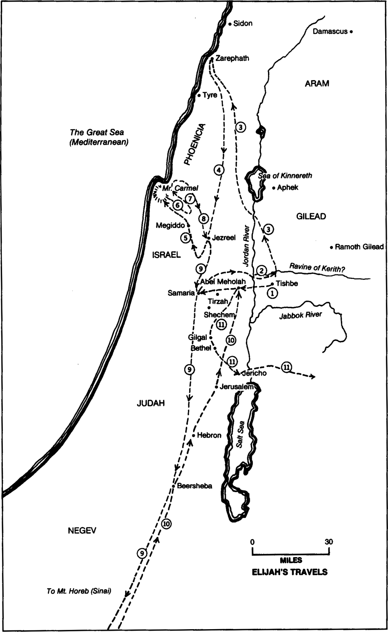
Sea of Galilee
Dead Sea

Slide 3
2 Kings 2:1
Now when the Lord was about to take Elijah up to heaven by a whirlwind, Elijah and Elisha were on their way from Gilgal.

Slide 4
2 Kings 2:2
And Elijah said to Elisha, “Please stay here, for the Lord has sent me as far as Bethel.” But Elisha said, “As the Lord lives, and as you yourself live, I will not leave you.” So they went down to Bethel.

Slide 5
2 Kings 2:3
And the sons of the prophets who were in Bethel came out to Elisha and said to him, “Do you know that today the Lord will take away your master from over you?” And he said, “Yes, I know it; keep quiet.”

Slide 6
2 Kings 2:4
Elijah said to him, “Elisha, please stay here, for the Lord has sent me to Jericho.” But he said, “As the Lord lives, and as you yourself live, I will not leave you.” So they came to Jericho.

Slide 7
2 Kings 2:5
The sons of the prophets who were at Jericho drew near to Elisha and said to him, “Do you know that today the Lord will take away your master from over you?” And he answered, “Yes, I know it; keep quiet.”

Slide 8
2 Kings 2:6
Then Elijah said to him, “Please stay here, for the Lord has sent me to the Jordan.” But he said, “As the Lord lives, and as you yourself live, I will not leave you.” So the two of them went on.

Slide 9
2 Kings 2:7
Fifty men of the sons of the prophets also went and stood at some distance from them, as they both were standing by the Jordan.

Slide 10
2 Kings 2:8
Then Elijah took his cloak and rolled it up and struck the water, and the water was parted to the one side and to the other, till the two of them could go over on dry ground.

Slide 11
Elijah Travels East
(2 Kings 2:1-8)

Slide 12
2 Kings 2:9
When they had crossed, Elijah said to Elisha, “Ask what I shall do for you, before I am taken from you.” And Elisha said, “Please let there be a double portion of your spirit on me.”

Slide 13
2 Kings 2:10
And he said, “You have asked a hard thing; yet, if you see me as I am being taken from you, it shall be so for you, but if you do not see me, it shall not be so.”

Slide 14
2 Kings 2:11
And as they still went on and talked, behold, chariots of fire and horses of fire separated the two of them. And Elijah went up by a whirlwind into heaven.

Slide 15
2 Kings 2:12
And Elisha saw it and he cried, “My father, my father! The chariots of Israel and its horsemen!” And he saw him no more. Then he took hold of his own clothes and tore them in two pieces.

Slide 16
Elijah’s Departure
(2 Kings 2:9-12)

Slide 17
2 Kings 13:14
Now when Elisha had fallen sick with the illness of which he was to die, Joash king of Israel went down to him and wept before him, crying, “My father, my father! The chariots of Israel and its horsemen!”

Slide 18
2 Kings 2:13
And he took up the cloak of Elijah that had fallen from him and went back and stood on the bank of the Jordan.

Slide 19
2 Kings 2:14
Then he took the cloak of Elijah that had fallen from him and struck the water, saying, “Where is the Lord, the God of Elijah?” And when he had struck the water, the water was parted to the one side and to the other, and Elisha went over.

Slide 20
Elisha Succeeds Elijah
(2 Kings 2:13-14)

Slide 21
The Jordan River
Wilderness / Promised Land
Moses / Joshua
Elijah / Elisha
John / Jesus

Slide 22
Reflections on the Life of Elijah

Slide 23
“Elijah was a man with a nature like ours”
(James 5:17)

Slide 24
Elijah remained faithful to God
“Elijah”: YHWH is God

