Slide 1
Life of Elijah, pt. 4
1 Kings 18:20-46

Slide 2
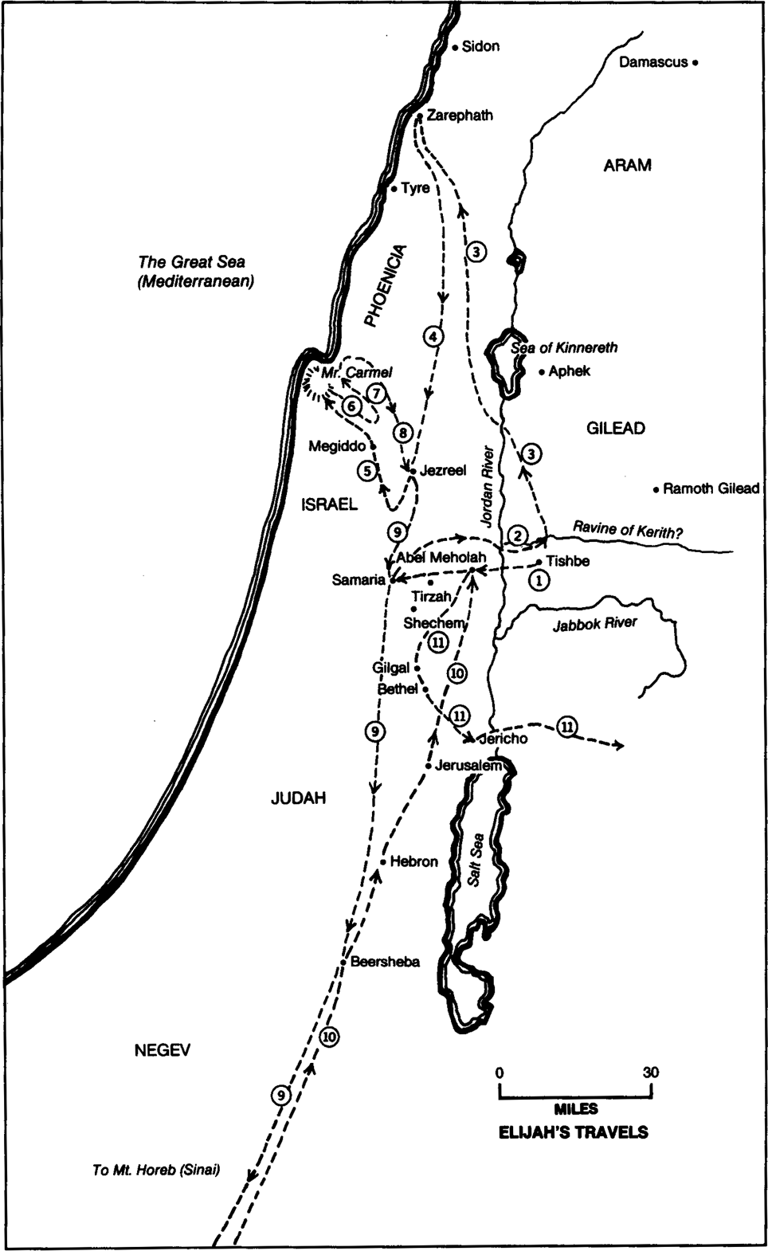
Sea of Galilee
Dead Sea

Slide 3
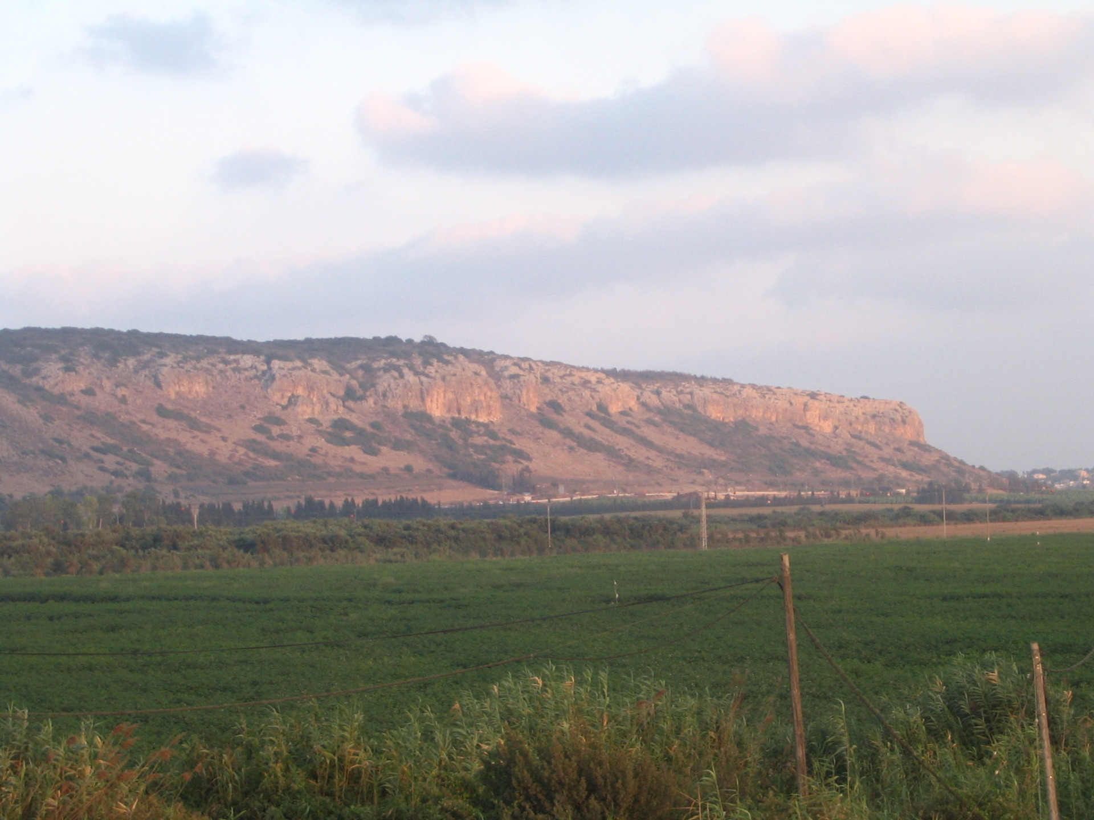
Mt. Carmel’s Southwest Face

Slide 4
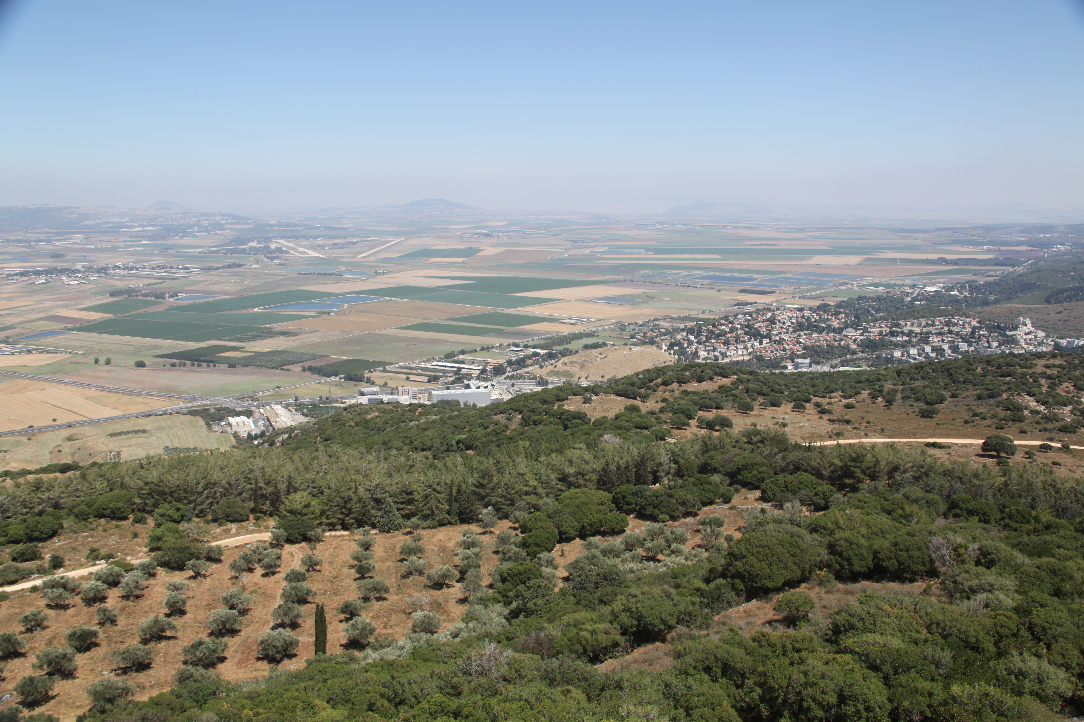
Jezreel Valley – On Mt. Carmel, looking east

Slide 5
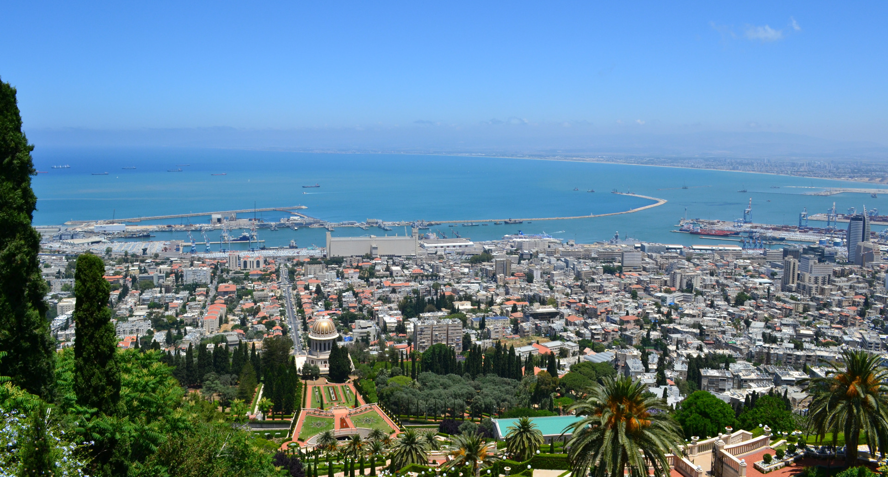
Bay of Haifa from Mt. Carmel
“Go up now, look toward the sea” (1 Kings 18:43)

Slide 6
1 Kings 18:20-21
So Ahab sent to all the people of Israel and gathered the prophets together at Mount Carmel. And Elijah came near to all the people and said, “How long will you go limping between two different opinions? If the Lord is God, follow him; but if Baal, then follow him.” And the people did not answer him a word.

Slide 7
1 Kings 18:22-23
Then Elijah said to the people, “I, even I only, am left a prophet of the Lord, but Baal's prophets are 450 men. Let two bulls be given to us, and let them choose one bull for themselves and cut it in pieces and lay it on the wood, but put no fire to it. And I will prepare the other bull and lay it on the wood and put no fire to it.

Slide 8
1 Kings 18:24-25
And you call upon the name of your god, and I will call upon the name of the Lord, and the God who answers by fire, he is God.” And all the people answered, “It is well spoken.” Then Elijah said to the prophets of Baal, “Choose for yourselves one bull and prepare it first, for you are many, and call upon the name of your god, but put no fire to it.”

Slide 9
Elijah’s Challenges (18:20-25)
Challenge to the people of Israel
Challenge to the priests of Baal

Slide 10
Elijah’s Challenges (18:20-25)
Challenge to the people of Israel
Challenge to the priests of Baal

Slide 11
1 Kings 18:26
And they took the bull that was given them, and they prepared it and called upon the name of Baal from morning until noon, saying, “O Baal, answer us!” But there was no voice, and no one answered. And they limped around the altar that they had made.

Slide 12
1 Kings 18:27-28
And at noon Elijah mocked them, saying, “Cry aloud, for he is a god. Either he is musing, or he is relieving himself, or he is on a journey, or perhaps he is asleep and must be awakened.” And they cried aloud and cut themselves after their custom with swords and lances, until the blood gushed out upon them.

Slide 13
1 Kings 18:29
And as midday passed, they raved on until the time of the offering of the oblation, but there was no voice. No one answered; no one paid attention.

Slide 14
Baal’s Silence
(18:26-29)

Slide 15
1 Kings 18:30-31
Then Elijah said to all the people, “Come near to me.” And all the people came near to him. And he repaired the altar of the Lord that had been thrown down. Elijah took twelve stones, according to the number of the tribes of the sons of Jacob, to whom the word of the Lord came, saying, “Israel shall be your name,”

Slide 16
1 Kings 18:32-33
and with the stones he built an altar in the name of the Lord. And he made a trench about the altar, as great as would contain two seahs of seed. And he put the wood in order and cut the bull in pieces and laid it on the wood. And he said, “Fill four jars with water and pour it on the burnt offering and on the wood.”

Slide 17
1 Kings 18:34-35
And he said, “Do it a second time.” And they did it a second time. And he said, “Do it a third time.” And they did it a third time. And the water ran around the altar and filled the trench also with water.

Slide 18
1 Kings 18:36-37
And at the time of the offering of the oblation, Elijah the prophet came near and said, “O Lord, God of Abraham, Isaac, and Israel, let it be known this day that you are God in Israel, and that I am your servant, and that I have done all these things at your word. Answer me, O Lord, answer me, that this people may know that you, O Lord, are God, and that you have turned their hearts back.”

Slide 19
1 Kings 18:38-39
Then the fire of the Lord fell and consumed the burnt offering and the wood and the stones and the dust, and licked up the water that was in the trench. And when all the people saw it, they fell on their faces and said, “The Lord, he is God; the Lord, he is God.”

Slide 20
1 Kings 18:40
And Elijah said to them, “Seize the prophets of Baal; let not one of them escape.” And they seized them. And Elijah brought them down to the brook Kishon and slaughtered them there.

Slide 21
YHWH’s Roar
(18:30-40)

Slide 22
1 Kings 18:41-42
And Elijah said to Ahab, “Go up, eat and drink, for there is a sound of the rushing of rain.” So Ahab went up to eat and to drink. And Elijah went up to the top of Mount Carmel. And he bowed himself down on the earth and put his face between his knees.

Slide 23
1 Kings 18:43-44
And he said to his servant, “Go up now, look toward the sea.” And he went up and looked and said, “There is nothing.” And he said, “Go again,” seven times. And at the seventh time he said, “Behold, a little cloud like a man's hand is rising from the sea.” And he said, “Go up, say to Ahab, ‘Prepare your chariot and go down, lest the rain stop you.’”

Slide 24
1 Kings 18:45-46
And in a little while the heavens grew black with clouds and wind, and there was a great rain. And Ahab rode and went to Jezreel. And the hand of the Lord was on Elijah, and he gathered up his garment and ran before Ahab to the entrance of Jezreel.

Slide 25
Running in the Rain
(18:41-46)

